Slide 1
STUDENT PERFORMANCE ANALYSER
By Kaushik and Siddharth

Slide 2
OBJECTIVE
We have tried to create an efficient analyser, that can do the following:
Give the user the initiative to add or upload Name, Enrollment ID, Marks of Three Courses,and store the data
Calculate the SGPA of the particular semester with the given data, and save the data.
Give a rough visual overview of the performance of the particular batch, through graphics.

Slide 3

PYTHON
We have used Tkinter module for displaying a GUI (Graphical User Interface) type system, so that the user can navigate with ease as compared to a console-based system.
Tkinter has lots of in-built widget features, pack functions,grid system and ability to integrate matplotlib for data visualization.
We have used Tkinter as the base for our system and we have used multiple windows to display our various features

Slide 4
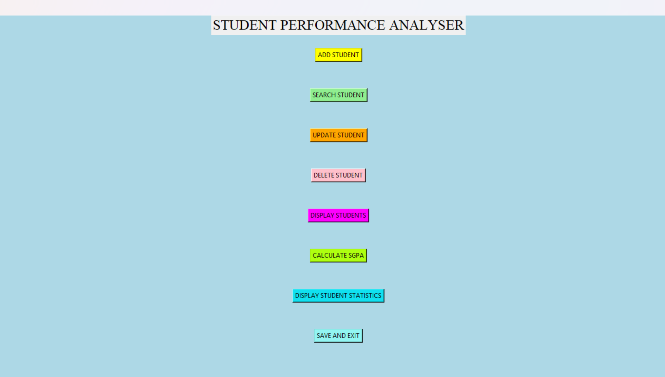
OVERVIEW OF THE STARTING WINDOW

Slide 5
FEATURES:
ADD STUDENT
SEARCH STUDENT
UPDATE STUDENT
DELETE STUDENT
DISPLAY STUDENTS
CALULATE SGPA
DISPLAY STUDENT STATISTICS
SAVE AND EXIT

Slide 6
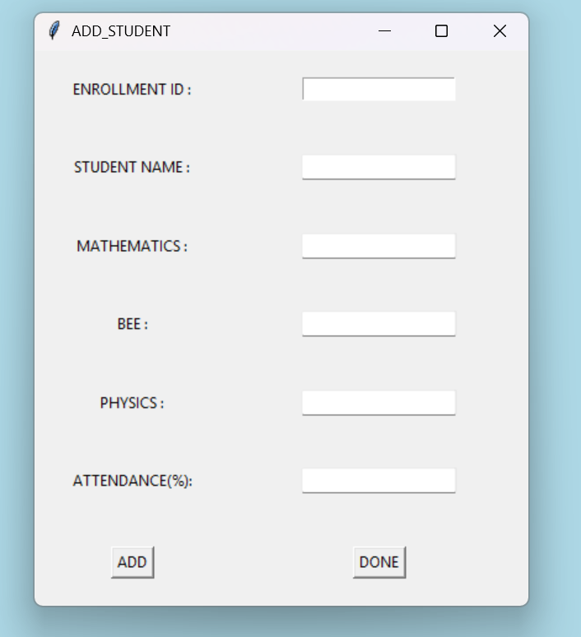
ADD STUDENT
The following shows the parameters of a particular student:
On clicking the add button, the details of a
particular student get added, given the entered
Values are valid.
On clicking done, the ADD_STUDENT window
gets closed.
All the records added,deleted,updated, are
stored in a list variable called students.

Slide 7
STUDENTS
Each element of the list students is a dictionary, containing key-value pairs, with the keys common for each student, as shown in the left column of the window.
The values are the actual details of the student according to the keys.
For example, “Name” key will have the actual name of the student as the value.

Slide 8
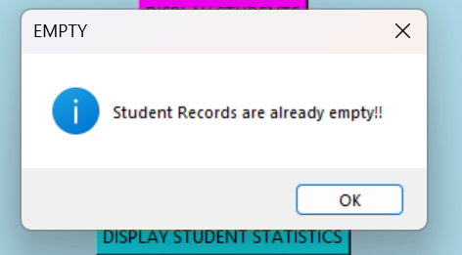
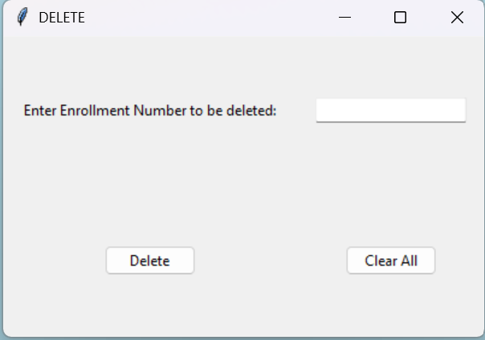
DELETE STUDENT
This is a relatively simpler function to use.
In case there are no student records, it will display a pop-up showing the records are empty.
In order to delete a student record from the database, just enter the correct ENROLLMENT ID of the student, in order to delete the entire student data.
The clear All button clears the entire student records.

Slide 9
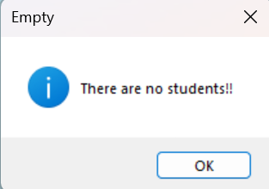
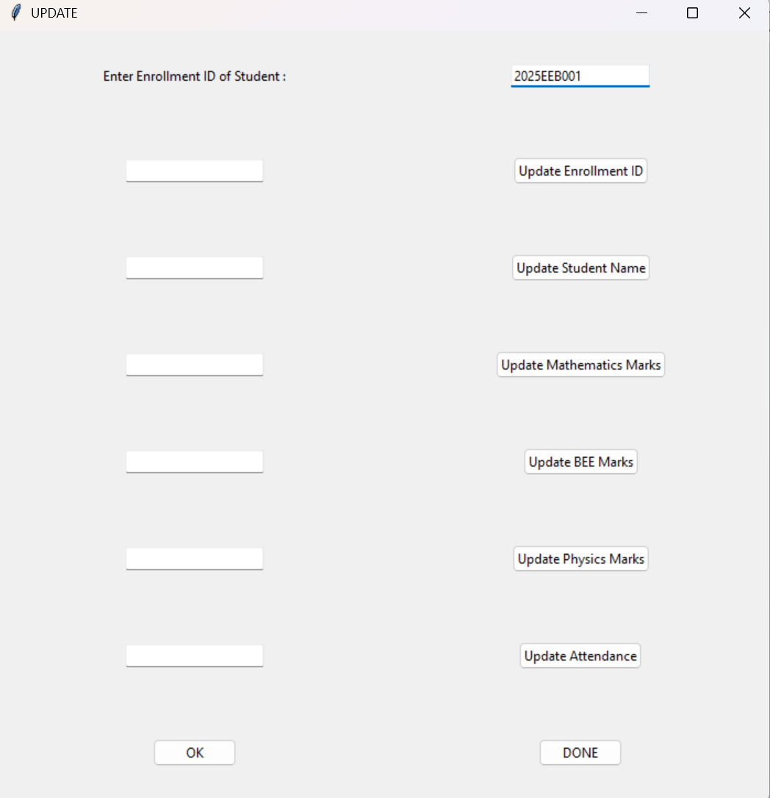
The following shows the system architecture to update the parameters of the student. As expected, in case the student record is empty, it will show the pop up box as shown above. In case the ENROLLMENT ID exists, it will show the grid as shown here. You can type in the updated name,enrolment number,marks, attendance, that is whichever parameter you want to update, and then click the corresponding button on the right. After finishing the changes for a student, you can click on OK, and the function will reset.

Slide 10
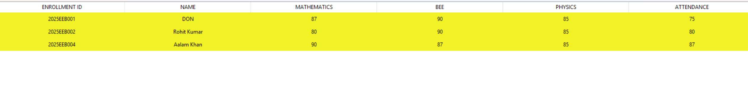
Display Students
The students list will be converted to a dataframe, and stored in the form of a table and if the record is not empty, the student list will be displayed in the form of a table.

Slide 11
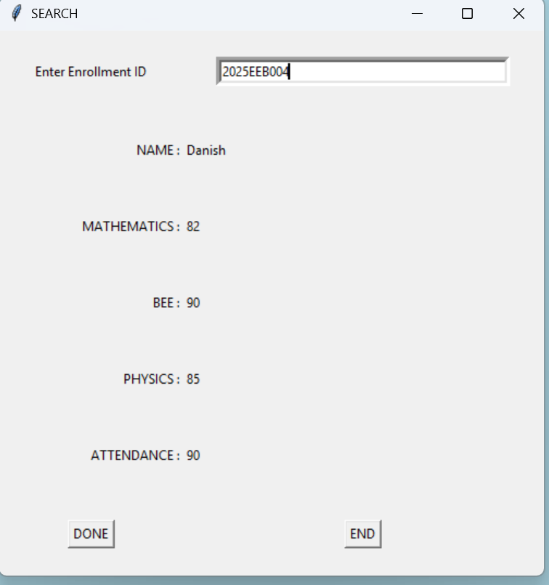
SEARCH STUDENT
As given in the right, students in any student record as searched by entering their unique ENROLLMENT ID, and if the the student exits, it will show the data of the particular student as shown.
If the student does not exist, it will display a pop-up as already
specified earlier that either the STUDENT RECORD IS EMPTY
,or the ENROLLMENT ID is not found.

Slide 12
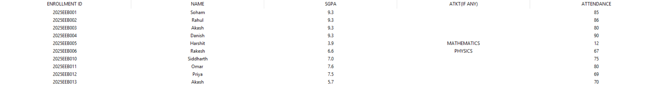
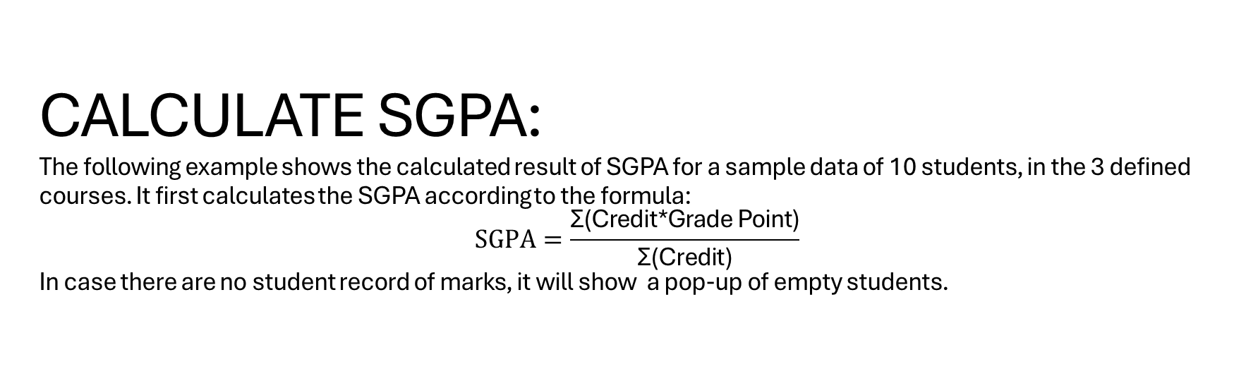
CALCULATE SGPA: The following example shows the calculated result of SGPA for a sample data of 10 students, in the 3 defined courses. It first calculates the SGPA according to the formula: $$SGPA=\frac{\text{Σ}\text{(}\text{Credit}\text{*}\text{Grade} \text{Point}\text{)}}{\text{Σ}\text{(}\text{Credit}\text{)}}$$ In case there are no student record of marks, it will show a pop-up of empty students.

Slide 13
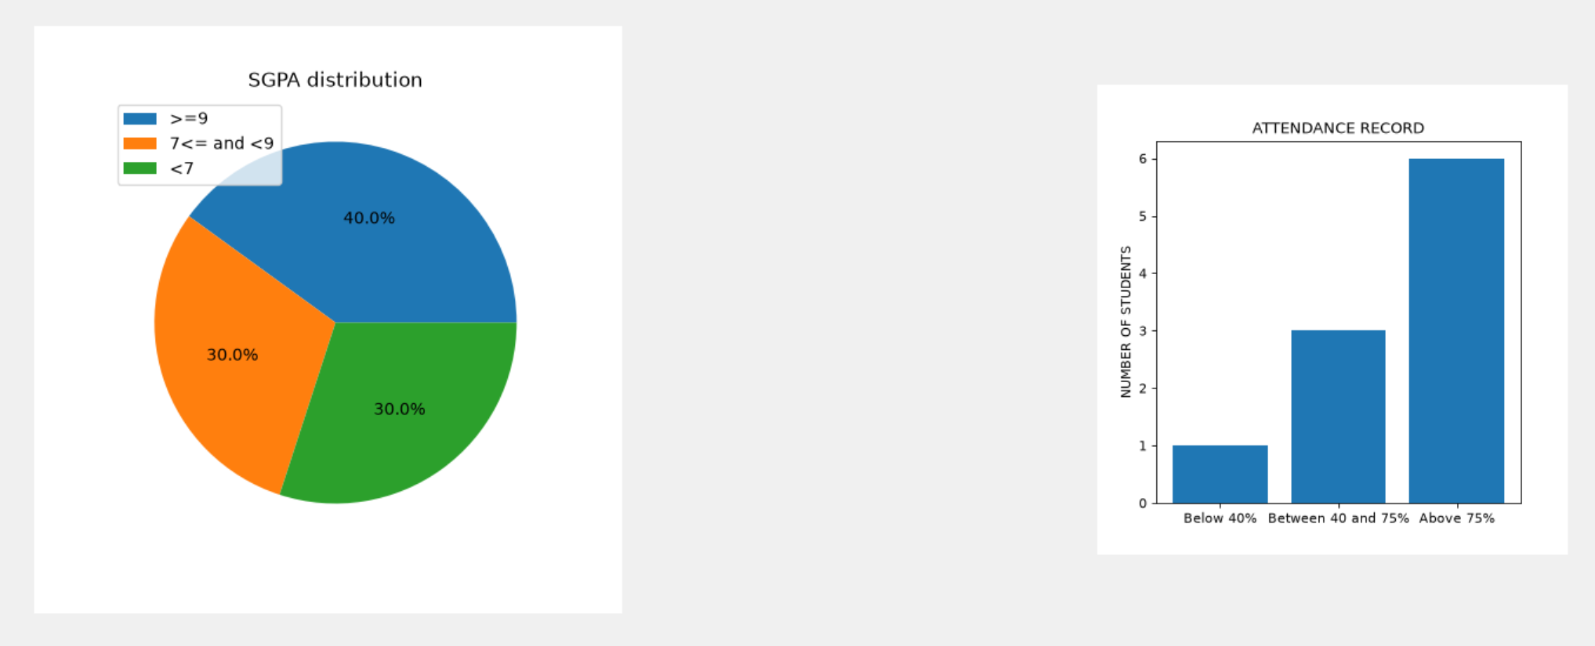
DISPLAY STUDENT STATISTICS

Slide 14
As shown in the previous slide, Matplotlib has been used to display the pie-chart of the CGPA distribution, and also the attendance which plays an important part in higher education.
A few features are yet to be added, but these two give a rough idea of the performance of the class.

Slide 15
ADVANTAGES:
Easy and effective to use, and maintain
Has Data Validation benefits: the program ensures no invalid enrollmement ID, marks, or attendance are entered.
Will provide a graphical, and true overview of the situation, and performance of the batch.

Slide 16
LIMITATIONS
Server make take time to load or save
Not as easy to edit or save as Microsoft Excel
The data frame can only store a record of maximum 60 students.
It is difficult to enter data like this, because un schools and colleges, there are more courses, and one user cannot have data of all different subjects like this.
There is no scope for course code currently in this project.

Slide 17
We hope to improve more upon the interface,to make it more user-friendly!!!!!
Thank you!!

